Slide 1
Chapter 2
How to code, test, and validate a web page

Slide 2
Objectives
Applied
Use a text editor to create and edit HTML and CSS files.
Test an HTML document that’s stored on your computer or a local server by loading it into a browser.
Validate an HTML document using a website like W3C Markup Validation Service.
Knowledge
Explain the purpose and use of the head and body elements in an HTML document.
Describe these types of HTML tags: opening, closing, and empty.
Describe the use of attributes within HTML tags.
Describe the use of HTML comments and whitespace.

Slide 3
Objectives (continued)
Describe the components of a CSS style rule.
Describe the use of these types of CSS selectors: type, id, and class.
Explain how and why you would start a new HTML or CSS file from a template.
Describe three ways to run a web page and one way to retest a page after you’ve changed the source code for the page.
Describe two benefits of validating HTML files.

Slide 4
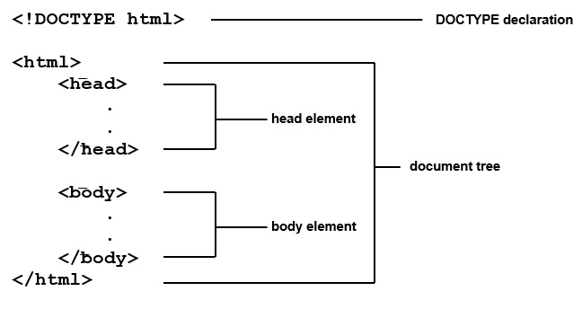
The basic structure of an HTML5 document

Slide 5
A simple HTML5 document
<!DOCTYPE html>
<html lang="en">
<head>
<meta charset="utf-8">
<title>San Joaquin Valley Town Hall</title>
</head>
<body>
<h1>San Joaquin Valley Town Hall</h1>
<p>Welcome to San Joaquin Valley Town Hall</p>
<p>We have some amazing speakers in store for you
this season!</p>
<p><a href="speakers.html">Speaker
information</a></p>
</body>
</html>

Slide 6
Working with tags
Two elements with opening and closing tags
<h1>San Joaquin Valley Town Hall</h1>
<p>Here is a list of links:</p>
Two empty tags
<br>
<img src="logo.gif" alt="Murach Logo">

Slide 7
Correct and incorrect nesting of tags
Correct nesting
<p>Order your copy <i>today!</i></p>
Incorrect nesting
<p>Order your copy <i>today!</p></i>

Slide 8
How to code an opening tag with attributes
An opening tag with one attribute
<a href="contact.html">
An opening tag with three attributes
<a href="contact.html" title="Click to Contact Us"
class="nav_link">
Note: Closing tags never contain attributes.

Slide 9
How to code an empty tag with attributes
<img src="logo.gif" alt="Murach Logo">

Slide 10
How to code a Boolean attribute
<input type="checkbox" name="mailList" checked>

Slide 11
Attributes for identifying HTML elements
An opening tag with an id attribute
<div id="page">
An opening tag with a class attribute
<a href="contact.html"
title="Click to Contact Us" class="nav_link">

Slide 12
A document with comments and whitespace
<!DOCTYPE html>
<!--This document displays the home page for the website-->
<html>
<head>
<title>San Joaquin Valley Town Hall</title>
</head>
<body>
<h1>San Joaquin Valley Town Hall</h1>
<h2>Bringing great speakers to the valley</h2>
<!-- This comments out the HTML code in the list
<ul>
<li>October: Jeffrey Toobin</li>
...
</ul>
The code after the end of this comment is active -->
<p>Contact us by phone for tickets</p>
</body>
</html>

Slide 13
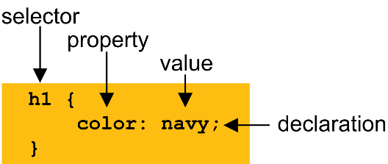
The parts of a CSS style rule

Slide 14
A simple CSS document with comments
/*********************************************************
* Description: Primary style sheet for valleytownhall.com
* Author: Anne Boehm
*********************************************************/
body {
background-color: #FACD8A; /* This is a shade of orange. */
}
h1 {
color: #363636;
}
h2 {
font-style: italic;
border-bottom: 3px solid #EF9C00; /* Add a line below h2s */
}
ul {
list-style-type: square; /* Changes the bullets to squares */
}

Slide 15
Elements can be selected by type, id, or class
<body>
<h1 class="base_color">Student materials</h1>
<p>Here are the links for the downloads:</p>
<ul id="links">
<li><a href="exercises.html">Exercises</a></li>
<li><a href="solutions.html">Solutions</a></li>
</ul>
<p id="copyright" class="base_color">Copyright 2018</p>
</body>

Slide 16
CSS style rules that select by type, id, and class
Type
body {
font-family: Arial, sans-serif;
font-size: 100%;
width: 300px;
padding: 1em; }
h1 {
font-size: 180%;
}
ID
#copyright {
font-size: 75%;
text-align: right;
}
Class
.base_color {
color: blue;
}

Slide 17
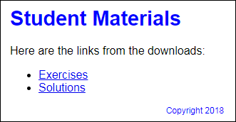
The elements in a browser

Slide 18
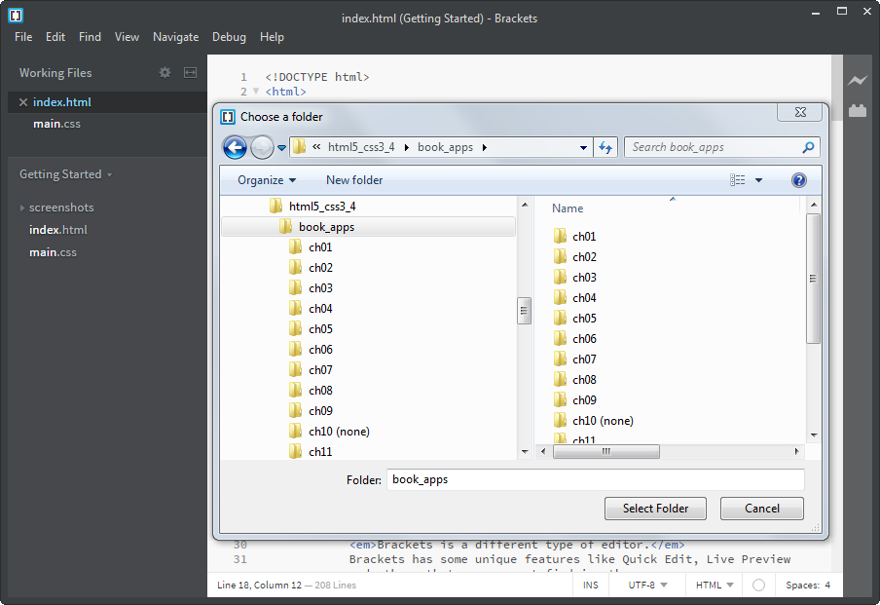
The Brackets dialog box for choosing a folder

Slide 19
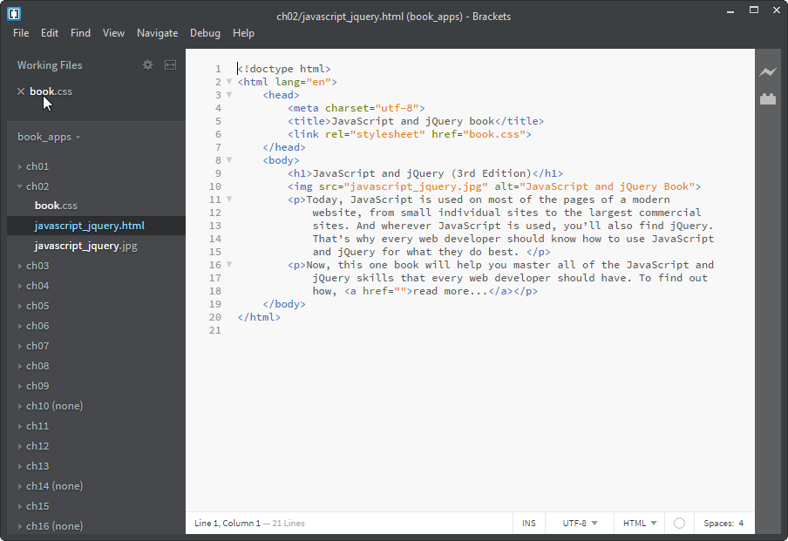
Brackets with an open file and a file displayed

Slide 20
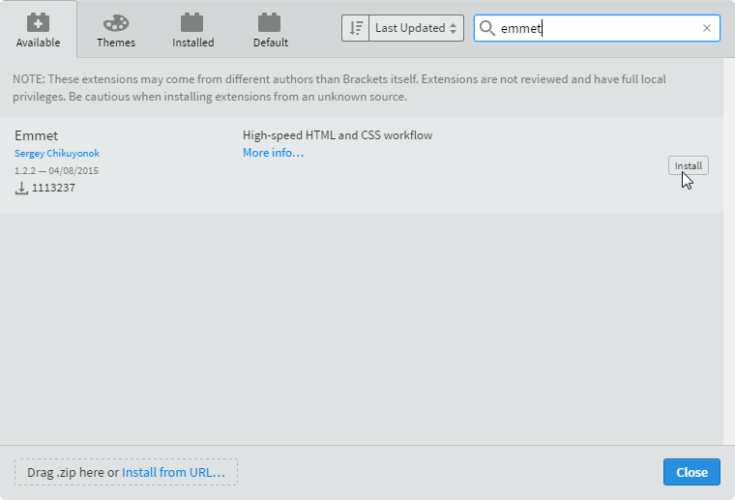
Brackets Extension Manager

Slide 21
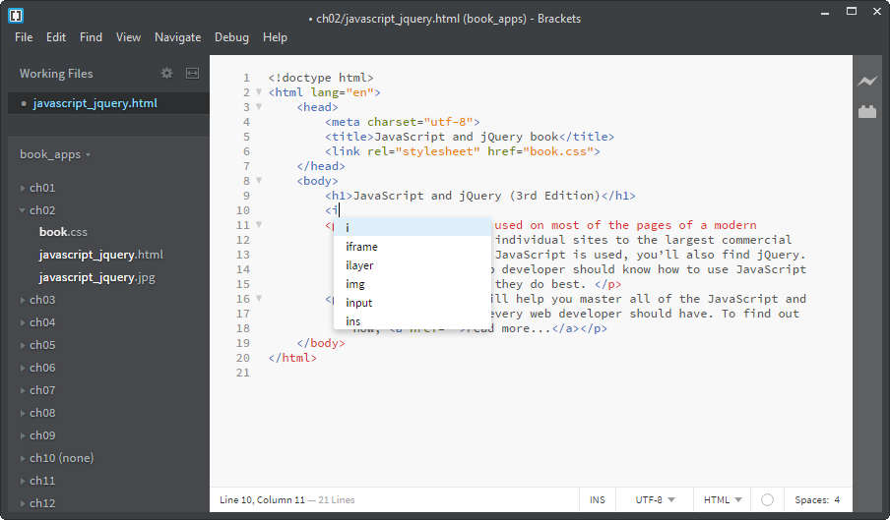
Brackets with HTML code hints

Slide 22
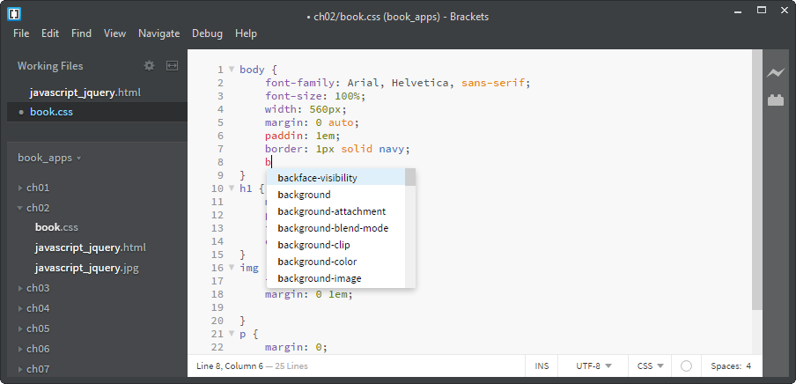
Brackets with CSS code hints

Slide 23
Common HTML and CSS errors
Common HTML errors
An opening tag without a closing tag.
Misspelled tag or attribute names.
Quotation marks that aren’t paired.
Incorrect file references in link, img, or <a> elements.
Common CSS errors
Braces that aren’t paired correctly.
Missing semicolons.
Misspelled property names.
ID or class names that don’t match the names used in the HTML.

Slide 24
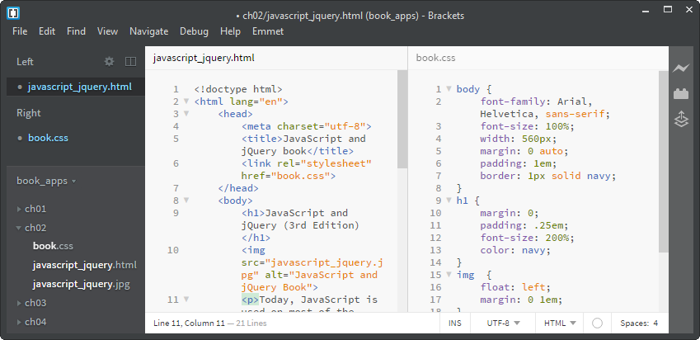
Brackets with a vertical split screen

Slide 25
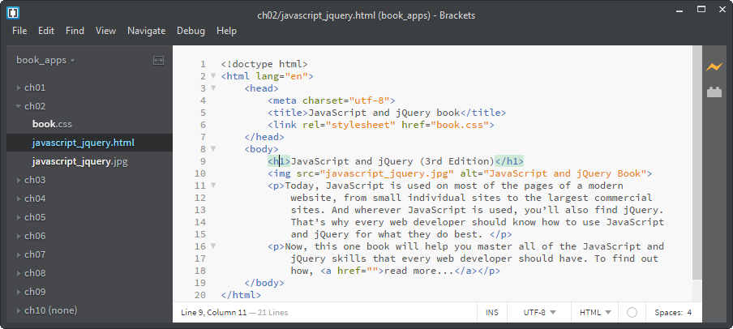
The Live Preview icon

Slide 26
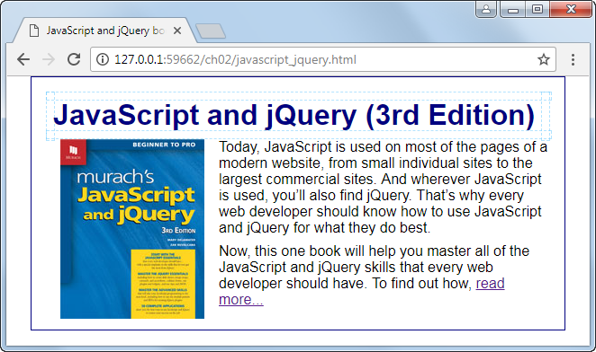
The Chrome browser in Live Preview

Slide 27
Three ways to run a web page that’s on your own computer
Start your browser, and use the File→Open or Open File command to open the file.
Use the file explorer on your system to find the HTML file, and double-click on it.
If you’re using Brackets, select the HTML file in the file tree and click the Live Preview icon to open the file in Chrome.

Slide 28
How to rerun a web page from a browser after you change its source code
Click the Reload or Refresh button in the browser.
Press F5 on your keyboard.
Press Ctrl+F5 on your keyboard to force a complete refresh.
Some IDEs / plugins will refresh the browser automatically.

Slide 29
How to test and debug a web page
How to test a web page
Run the page in all of the browsers that are likely to access your site.
Check the contents and appearance of the page to make sure it’s correct in all browsers.
Click on all of the links to make sure they work properly.
How to debug a web page
Find the causes of the errors in the HTML or CSS code, make the corrections, and test again.

Slide 30
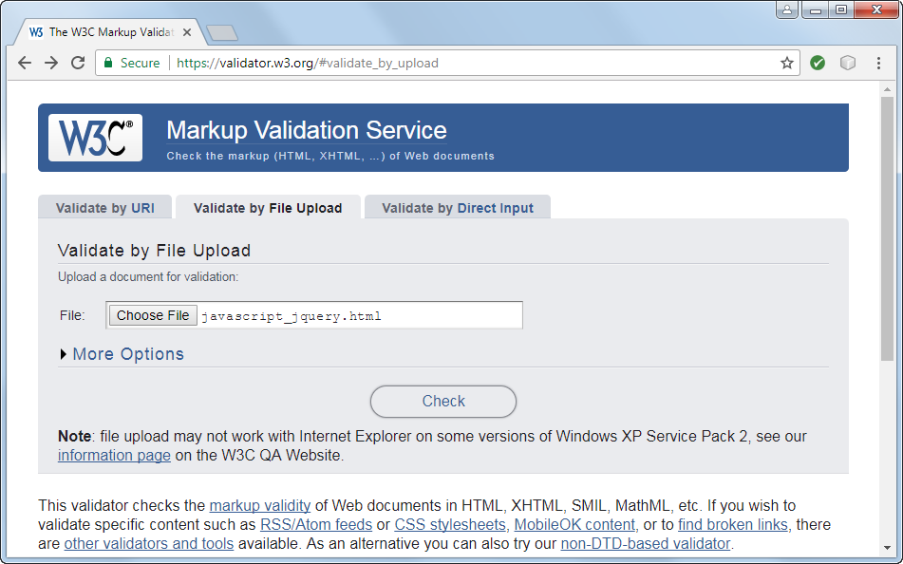
The home page for the W3C validator

Slide 31
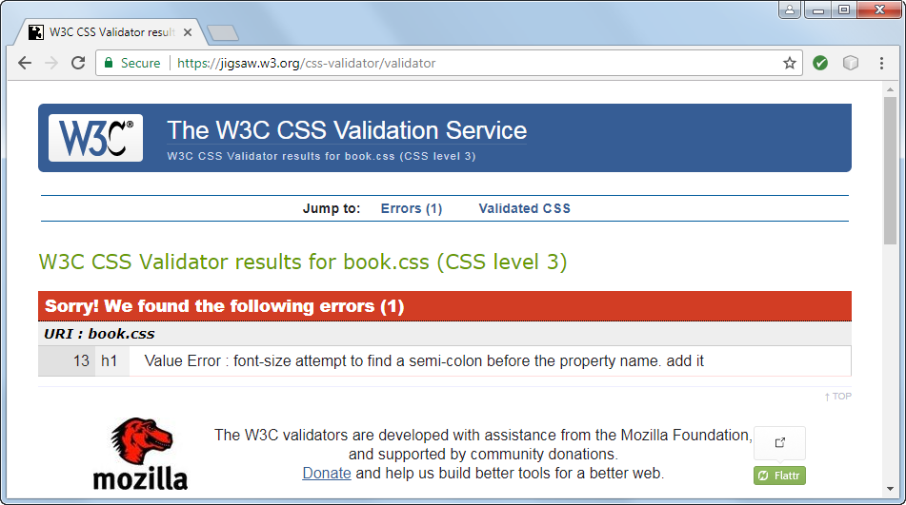
The CSS Validation Service with errors displayed

Slide 32
Objectives
Applied
Use a text editor to create and edit HTML and CSS files.
Test an HTML document that’s stored on your computer or a local server by loading it into a browser.
Validate an HTML document using a website like W3C Markup Validation Service.
Knowledge
Explain the purpose and use of the head and body elements in an HTML document.
Describe these types of HTML tags: opening, closing, and empty.
Describe the use of attributes within HTML tags.
Describe the use of HTML comments and whitespace.

Slide 33
Objectives (continued)
Describe the components of a CSS style rule.
Describe the use of these types of CSS selectors: type, id, and class.
Explain how and why you would start a new HTML or CSS file from a template.
Describe three ways to run a web page and one way to retest a page after you’ve changed the source code for the page.
Describe two benefits of validating HTML files.

